Slide 1
Discovery of K-enhanced and possibly Mg-depleted stars throughout the Milky Way
Alex Kemp (School of Physics & Astronomy, Monash University)
Collaborators: Andrew Casey, Mathew Miles, Brodie Norfolk, John Lattanzio, Amanda Karakas, Kevin Schlaufman, Anna Ho, Christopher Tout, Melissa Ness, Alexander Ji
Milky Way
Image Credit:
NASA
Notes:
Intro Self
Read title
Segue: ‘These stars are interesting in the context of a problem called ‘The Mg-K anticorrelation’, but before I talk about that specifically, I wanted to briefly mention why we should care about the abundances in stars in general?

Slide 2
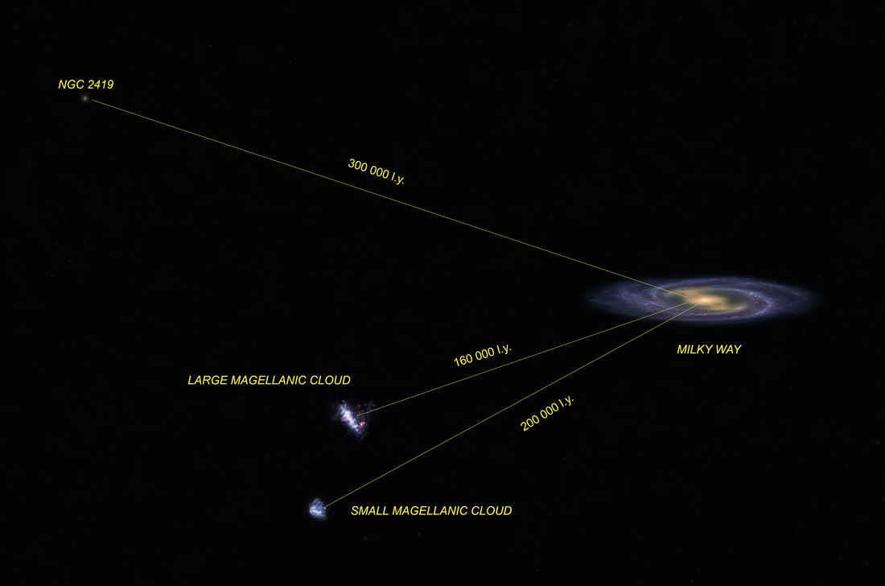
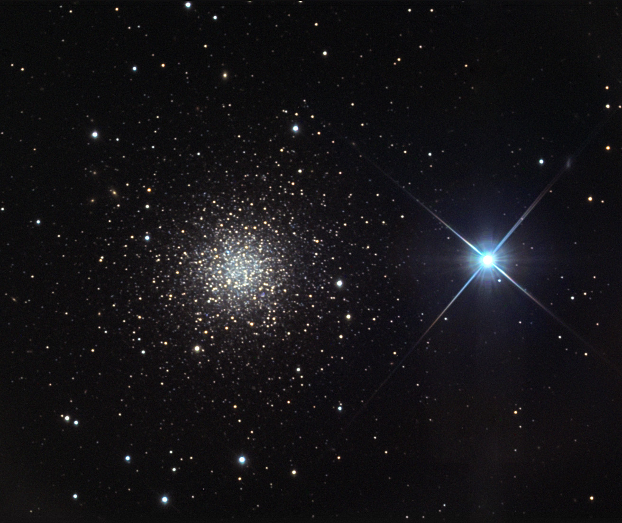
The Mg-K anti-correlation Patient Zero: NGC 2419
Distant and luminous globular cluster
Old and metal poor ([Fe/H]∽-2)
NGC 2419
Doug Matthews and Charles
Betts/Adam Block/NOAO/AURA/NSF
Iridia-observatory.org
Notes:
When you speak of the Mg-K anticorrelation, you have talk about NGC 2419.

Slide 3
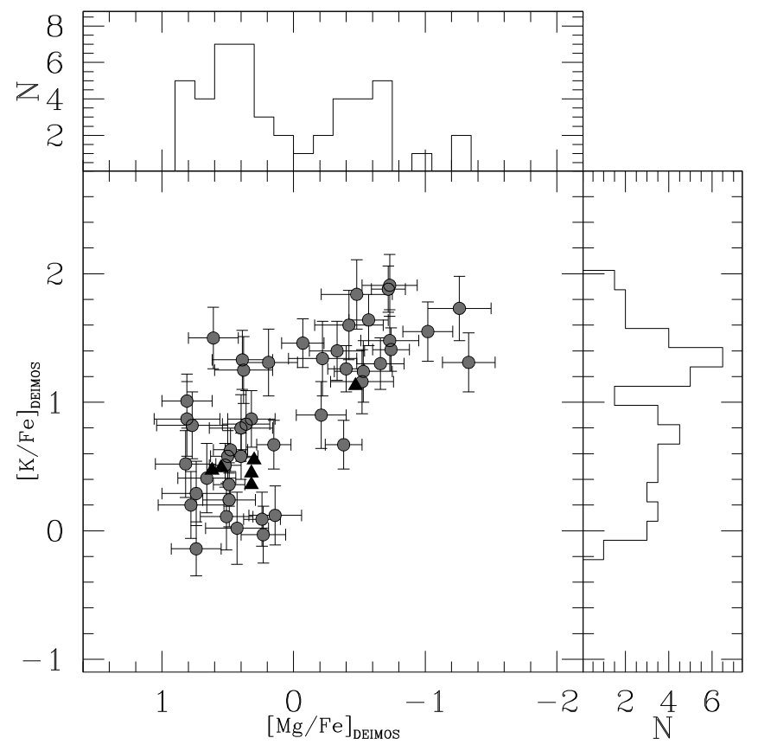
NGC 2419: The Mg-K Anti-Correlation
Muciarelli et al. (2012) (DEIMOS)
Two populations observed:
‘Normal’ population (∽60%)
‘Extreme’ Mg-depleted, K-enhanced population (∽40%)
Cohen & Kirby (2012) (HIRES)
Notes:
In 2012, when taking high resolution spectra of stars in NGC 2419, Cohen and Kirby found that there appeared to be two populations of stars in the cluster characterized by their Mg and K abundances…
We currently have no explanation for the existence of this population of stars.

Slide 4
The stars in NGC 2419 aren’t producing the anomaly
The extreme stellar population in NGC 2419 formed from polluted material.
Specifically, material which already contained the Mg-K anti-correlation.
Envelope
Shell
Core
Notes:
A word about what these measurements actually are:
The abundances in the previous slide were derived using stellar spectroscopy, which can only measure abundances in the outer envelopes of stars, where the nucleosynthesis isn’t happening.
Rather, the envelope is indicative to the material which formed the star.

Slide 5
The big question of the Mg-K anti-correlation in NGC 2419
What was the nature of this polluter?
Notes:
What was the nature of the source of the pollution material?

Slide 6
What was the nature of this polluter?
Theoretical Approach: Do some modelling, trying to produce enough material to produce the extreme population.
Notes:
If we attempt to answer this question, we might take one of two approaches…
What sort of clues are we talking about here?...

Slide 7
Pick a scenario, see what happens Eg. SAGB star
Pentagon 1: Ar-K at literature X-section
Pentagon 2: Ar-K at 100 * literature X-section
Pentagon 3: Ar-K at 100 * literature X-section AND reduce mass loss rate to 1/4
Ventura et al (2012)
Notes:
If we attempt to answer this question, we might take one of two approaches…
What sort of clues are we talking about here?...

Slide 8
Attempt to find a parameter space that works, use that to motivate a scenario
Nuclear network calculations attempting to match:
Mg, K, Si, Ca, Sc, Ti, V
Iliadis et al (2016)
Notes:
If we attempt to answer this question, we might take one of two approaches…
What sort of clues are we talking about here?...

Slide 9
What was the nature of this polluter?
Theoretical Approach: Do some modelling, trying to produce enough material to produce the extreme population.
Observational Approach: Look for clues to constrain and guide the models.
Notes:
If we attempt to answer this question, we might take one of two approaches…
What sort of clues are we talking about here?...

Slide 10
Clues/Constraints
Other abundances
Require enough material to be produced to pollute around 40% of the cluster.
Rarity?
Is this chemical signature unique to NGC 2419?
Notes:
Other abundances such as any trends or spreads in iron.
We have to produce enough material to account for the observed stars
How contrived can/must we be? Do we need a very rare configuration, or a more common one?

Slide 11
Beyond NGC 2419? Other Works
Carretta et al (2013):
NGC 104 (47 Tuc), ⍵ Cen, NGC 6752, NGC6121, NGC1904, NGC 7099, NGC 6397, +21 field stars
(UVES) Total stars: 98.
Mucciarelli et al (2015):
NGC 2808
Černiauskas et al (2017):
NGC 104 (47 Tuc).
(2dF/HERMES) Total stars: 32
Mucciarelli et al (2017):
NGC 104 (47 Tuc), NGC 6752, NGC 6809 (FLAMES) Total stars: 429
No correlation between Mg and K.
No significant intrinsic spreads in Mg or K.
Statistically significant anti-correlation between Mg and K, very little spread in K
Notes:
Various groups have searched for the signature outside of NGC2419
Searches typically involve taking medium or high resolution spectra of O(100) stars
In general, they find nada.
Exception: NGC2808
UVES is high resolution, R∽43000 (ESO)
HERMES is high resolution (R∽28000 to 50000) AAT
FLAMES: can do medium or high (R∽5000 to R∽30000) (ESO)

Slide 12
Beyond NGC 2419? Our Work
Searched: 450180 low resolution LAMOST giant spectra
Found: 112 candidate stars exhibiting enhanced [K/Fe] and potentially reduced [Mg/Fe]
Notes:
We searched 450 thousand stars, not hundreds, but hundreds of thousands, with the cost that we searched low resolution spectra from LAMOST.
We found 112 stars exhibiting extreme abundances of [K/Fe] and potentially reduced [Mg/Fe] abundances.
Now, in between the searching and the finding we did of course have a method, which I will very briefly relate:

Slide 13
The absolute bare bones of the methodology
Take data-driven model produced by The Cannon for each giant spectra from LAMOST
Fit Gaussians to the residuals of the model and the flux spectra at Mg and K lines
Apply a match filter based on the characteristics of the fitted Gaussians
Manually inspect candidates individually
Notes:
We took our data-driven model from The Cannon, and then we fit Gaussians to the residuals of the model and the flux spectra. We then apply a match filter based on the characteristics of the fitted Gaussian to pare down our 450 thousand star sample to a several hundred promising stars before manually inspecting the candidates for unconvincing cases and false positives.

Slide 14
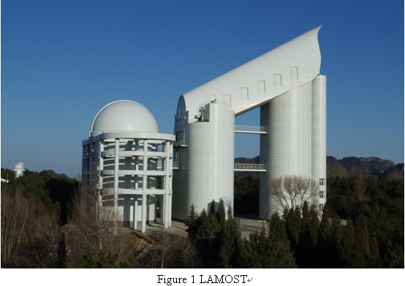
Take data-driven model produced by The Cannon for each giant spectra from LAMOST
Large Sky Area Multi-Object Fibre Spectroscopic Telescope (R∽500 to 1500)
Large Aperture, Wide FOV Telescope
Up to 4000 spectra obtained per exposure to a limiting magnitude of up to r=19 at R=1800 resolution.
LAMOST Telescope (LAMOST.org)
Ma | Mb | Clear Aperture | FoV | Focal Plane | Focal Length | Fibres | Spectral Ranges | R | Limit Mag | Spectral resolution | Observable Sky
5.72mx4.4m | 6.67m x6.05m | 4m | 5º | f 1.75m | 20m | 4000 | 370nm-900nm | 500, 1000, 1500 | 20.5m (1.5hr, R=500) | 1/0.25nm | -10º -+90º Declination
Notes:
UVES is high resolution, R∽43000 (ESO)
HERMES is high resolution (R∽28000 to 50000) AAT
FLAMES: can do medium or high (R∽5000 to R∽30000) (ESO)

Slide 15
Take data-driven model produced by The Cannon for each giant spectra from LAMOST
A Machine Learning Code developed to perform label transfer between stellar surveys and model stellar spectra.
Label Transfer: Using ‘well known’ labels (eg. Teff, Log(g)…) from one survey to obtain a more accurate estimate for the labels for another survey.
The data driven model is trained using stars common to both surveys.
The model is some function of the labels: F(label1,label2…)
Survey A (more accurate)
Common Stars
Survey B (less accurate)
Model
Notes:
UVES is high resolution, R∽43000 (ESO)
HERMES is high resolution (R∽28000 to 50000) AAT
FLAMES: can do medium or high (R∽5000 to R∽30000) (ESO)

Slide 16
Take data-driven model produced by The Cannon for each giant spectra from LAMOST
Label Transfer is effected by The Cannon determining the values of the labels that result in the best overall fit for a spectra by the model F(label1,label2…)
Survey A (more accurate)
Common Stars
Survey B (less accurate)
Model
Notes:
UVES is high resolution, R∽43000 (ESO)
HERMES is high resolution (R∽28000 to 50000) AAT
FLAMES: can do medium or high (R∽5000 to R∽30000) (ESO)

Slide 17
Take data-driven model produced by The Cannon for each giant spectra from LAMOST
9952
Common Stars
APPOGEE DR 12
(Alam et al 2015)
LAMOST DR2
(Luo et al 2016)
Model
Model parameters: T_{eff}, log(g), [Fe/H], [ɑ/Fe], A_{v}
The model represents a ‘typical’ star for those model parameters.
We search for stars that exhibit deviations from the model consistent with depletions in [Mg/Fe] and enhancements in [K/Fe]
Notes:
UVES is high resolution, R∽43000 (ESO)
HERMES is high resolution (R∽28000 to 50000) AAT
FLAMES: can do medium or high (R∽5000 to R∽30000) (ESO)

Slide 18
Sample Candidate Spectrum
LAMOST spectrum and best fitting model from The Cannon for candidate star J075043.1+204658
Notes:
So this is what the data looks like, the red is the model from The Cannon…
Whats an over abundance relative to normal looks like, same with a depletion

Slide 19
[Fe/H], log(g), T_{eff}
Candidates found throughout our sample of LAMOST giants
Notes:
This slide shows something of the parameter space of our sample.

Slide 20
[Mg/Fe], ([ɑ/Fe]), [K/Fe]
Unable to determine [Mg/Fe] for our stars…
[ɑ/Fe] plotted for our stars, treated as upper limit for [Mg/Fe]
Significant enhancement in [K/Fe]
Notes:
At this point a limitation of our work becomes relevant: we are unable to derive numeric abundances for [Mg/Fe]
In this figure we compare our stars with the stars in NGC 2419, NGC 2808 and some galactic field stars from APOGEE

Slide 21
[K/Fe], [Fe/H]
A negative trend is observed with [Fe/H]
If we dared to extend the line, it would pass nicely through the extreme population of NGC 2419…
Notes:
This figure is similar to the previous, but rather than plot against [Mg/Fe], we plot against [Fe/H].

Slide 22
So what does it mean for the polluters?
Rarity?
Observation: found stars with similar levels of [K/Fe], but none exceeding the most extreme members of NGC 2419. These stars may be somewhat depleted in [Mg/Fe].
Implication: The high enhancements in [K/Fe] are not unique to NGC 2419, and possibly the Mg-K anti-correlation isn’t either.
Notes:
We did find some stars with similar levels of [K/Fe], and they may even be depleted in [Mg/Fe].
However, in 450 thousand stars, not one did we find that had [K/Fe] higher than NGC 2419.

Slide 23
So what does it mean for the polluters?
Metallicity?
Observation: Candidates are spread across metallicities ranging from approximately -1.4 to +0.4 dex.
Implication: The pollution event may not be constrained to a specific epoch in the Galaxy’s evolution.
Notes:
The other big clue you might take away from our work in the distribution of metallicities where we found our candidates.
We found them all the way from -1.4 all the way up to +0.4 dex! That’s a factor of a hundred in range…
The implication is that the pollution event may not be constrained to a specific epoch in galactic evolution

Slide 24
Summary
Searched 450180 LAMOST spectra to find 112 stars with extremely high [K/Fe] and possibly low [Mg/Fe], but none as extreme as the stars found in NGC 2419.
These stars have [Fe/H] ∽ -1.4 to +0.4.
Findings argue against metallicity constrained pollution candidates, instead favour polluters that can exist throughout the Milky Way.

Slide 25
Let’s forget about NGC 2419 for a moment…
What about trying to explain just our stars?
We might start with a binary like this one
Star 1: Super-Asymptotic Giant Branch (SAGB) star (8-10 M☉)
Star 2: some low-intermediate mass star (2-5 M☉)
Star 1
(SAGB)
(M₁>M₂)
Star 2
(MS)
Notes:
Implicit in all of the previous has been the assumption that the mechanism responsible for our stars is at least similar to NGC 2419… What if we relax that assumption, and just try and come up with a plausible handwavy scenario that might explain our stars?
Well, we might start with a binary like this one.

Slide 26
Let’s forget about NGC 2419 for a moment…
What about trying to explain just our stars?
Star 1
(SAGB)
Star 1 produces K that is then mixed through its outer layers.
(M₁>M₂)
Star 2
(MS)

Slide 27
Let’s forget about NGC 2419 for a moment…
What about trying to explain just our stars?
Star 1
(SAGB)
Star 1 produces K that is then mixed through its outer layers.
Star 1 deposits some fraction of its outer layers onto its lower mass companion, increasing its mass to M₂*, before forming a O-Ne white dwarf remnant.
(M₁>M₂)
Star 2
(MS)

Slide 28
Let’s forget about NGC 2419 for a moment…
What about trying to explain just our stars?
Star 1
(SAGB)
Star 1 produces K that is then mixed through its outer layers.
Star 1 deposits some fraction of its outer layers onto its lower mass companion, increasing its mass to M₂*, before forming a O-Ne white dwarf remnant.
Star 2 may undergo hot bottom burning (depending on M₂*) potentially depleting Mg through Mg-Al chains.
(M₁>M₂)
Star 2
(MS)
2*
(AGB)
1
(ONe WD)
(M₁<M₂<M₂*)
Notes:
We’re not saying this is what’s responsible for our stars, and certainly this scenario doesn’t explain NGC 2419, but this is I suppose an example of the kind of processes one might invoke

Slide 29
BONUS SLIDES: Candidate Selection: Match Filter
Fit Gaussian profiles to residuals at each line of the Mg triplet and the K doublet (5167 Å, 5172 Å, 5184 Å, 7665 Å, 7699 Å).
Characterized deviation using Gaussian amplitude A
Analogous to depth of absorption line, in principle linearly dependent on the equivalent width.
+ve A -> enhancement, -ve A -> depletion
Candidates match one of:
A_{Mg@5184} > 0.05 & A_{K@7665} < -0.05 & both amplitudes to satisfy |A|/σ_{A} ≥ 3.
2/3 A_{Mg@xxxx} > 0.05 & at least one A_{K@xxxx}< -0.05 & for those amplitudes to satisfy |A|/σ_{A} ≥ 3.
2/3 A_{Mg@xxxx} > 0 & both A_{K@xxxx}< 0 & signal-to-noise (S/N) >30 & χ_{r}² < 3.

Slide 30
BONUS SLIDES: Candidate Selection: Visual Inspection
Match Filter Output: 384 stars
Visually inspected all spectra for false positives and unconvincing candidates, including stars exhibiting signs of:
Data-reduction issues (excessive noise, inherently poor fit in all regions)
Apparent absorption narrower than the expected spectral resolution
Signs of chromospheric emission at Hɑ lines (implies star is young, and has been misclassified as a giant)
Visual Inspection Output: 112 stars

Slide 31
Association with Globular Clusters
No obvious or plausible cluster associations based on angular position.
In particular the stars cannot be associated with either NGC 2419 or NGC 2808
NGC 2419
NGC 2808
Globular cluster data from Harris 1996

Slide 32
IMPORTANT DETAIL: Estimating abundances
[Mg/Fe], [K/Fe]
[Mg/Fe]: Difficult to separate contributions of [Mg/Fe] from [ɑ/Fe] using the data-driven model, so we cannot estimate [Mg/Fe] in this way.

Slide 33
BONUS SLIDES: Pollution Sites and the challenge of replicating the Mg-K Anti-correlation.
Producing K is very difficult. It can be done through Ar-K chains, but requires very high temperatures and densities to produce enough K to explain the K enhancements in NGC 2419.
Producing Mg is comparatively easy… its a major product of carbon burning.
Depleting Mg can be done through Mg-Al chains, which may become active in hot-bottom burning (HBB) in some AGB stars.
Coming up with a pollution scenario that can reconcile these requirements is very difficult, made more so by the constraint that it must do so without producing Fe.
Potential polluters suggested in the past include novae, SAGB stars, and pair-instability supernovae (PISNs), but each of these comes with its own set of issues.
Notes:
Both HIRES and DEIMOS are at Keck. DEIMOS is medium resolution spectrograph, HIRES is high resolution spectrograph.

